Slide 1

MUSIC GENRE TEXT CLASSIFICTION

Slide 2
DATA SET
https://huggingface.co/datasets/maharshipandya/spotify-tracks-dataset/tree/main
This is a dataset of Spotify tracks over a range of 125 different genres. Each track has some audio features associated with it. The data is in CSV format which is tabular and can be loaded quickly.
The data set has over 114,000 samples, where training samples are 100,000 and testing samples are 14,000

Slide 3
IMPORTANT FEATURES IN DATA SET
track_id: The Spotify ID for the track
artists: The artists' names who performed the track. If there is more than one artist, they are separated by a ;
album_name: The album name in which the track appears
popularity: The popularity of a track is a value between 0 and 100, with 100 being the most popular. The popularity is calculated by algorithm and is based, in the most part, on the total number of plays the track has had and how recent those plays are. Generally speaking, songs that are being played a lot now will have a higher popularity than songs that were played a lot in the past. Duplicate tracks (e.g. the same track from a single and an album) are rated independently. Artist and album popularity is derived mathematically from track popularity.

Slide 4
IMPORTANT FEATURES IN DATA SET
duration_ms: The track length in milliseconds
speechiness: Speechiness detects the presence of spoken words in a track. The more exclusively speech-like the recording (e.g. talk show, audio book, poetry), the closer to 1.0 the attribute value. Values above 0.66 describe tracks that are probably made entirely of spoken words. Values between 0.33 and 0.66 describe tracks that may contain both music and speech, either in sections or layered, including such cases as rap music. Values below 0.33 most likely represent music and other non-speech-like tracks
track_name: Name of the track

Slide 5
time_signature: An estimated time signature. The time signature (meter) is a notational convention to specify how many beats are in each bar (or measure). The time signature ranges from 3 to 7 indicating time signatures of 3/4, to 7/4.
acousticness: A confidence measure from 0.0 to 1.0 of whether the track is acoustic. 1.0 represents high confidence the track is acoustic
track_genre: The genre in which the track belongs
The data was collected and cleaned using Spotify's Web API and Python.

Slide 6
CLASSIFICATION METHODS:
Currently, we have implemented two classification methods:
1.Decision Tree
2.Naive Bayes Theorm

Slide 7
Decision Tree Algorithm
A decision tree algorithm recursively splits a dataset into subsets based on feature values, aiming to achieve pure (homogeneous) leaf nodes in terms of the target variable.
Libraries Used: Sci-Kit Learn(Decision tree classifier, accuracy, label encoder, confusion matrix), pandas, numpy.

Slide 8
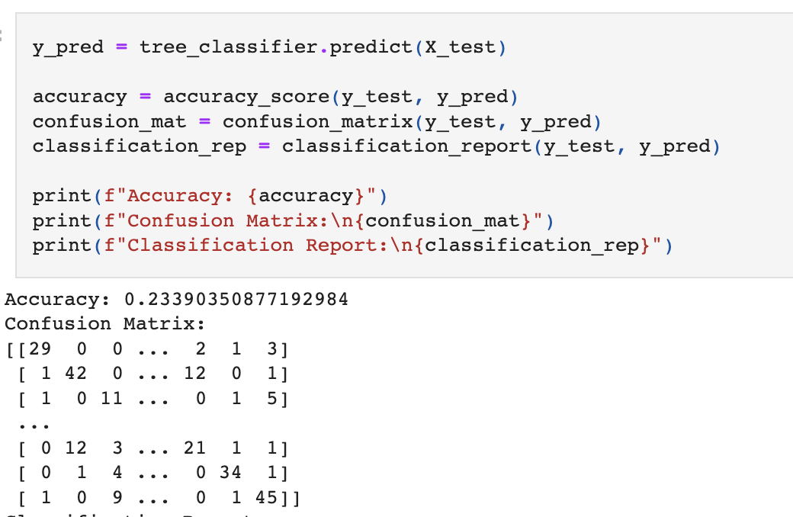
Decision Tree Algorithm - Outputs
We have Implemented descion tree algorithm and calculated the accuracy confusion matrix and classification report.
Since , We are getting 25% accuracy , to improve the accuracy we used different methods like pruning and binning

Slide 9
Decision Tree Algorithm - Outputs
Accuracy after implementing pruning is 21.4%
Let's bin these variables : popularity, duration_ms, danceability, energy, loudness, speechiness, acousticness, instrumentalness, liveness, valence, and tempo. We set the bins based on the data description given in the readme file.
Accuracy after implementing binning method is 17.1%
Even after binning and re-prunning our tree, we still are stuck at below 25% accuracy. Since we have seemingly exhausted our options for improving our tree, we can safely assume that decision tree is not a great algorithm for our goal. Alternatively, maybe our data just is not capable of making a good prediction overall.

Slide 10
Naive Bayes Algorithm
A Naive Bayes algorithm calculates the probability of a label given a set of features by applying Bayes' theorem, assuming that the features are conditionally independent given the label.
Libraries Used: Sci-Kit Learn(GaussianNB, train_test_split accuracy, label encoder, confusion matrix), pandas, numpy.

Slide 11
Naïve Bayes Algorithm - Outputs
We have Implemented naïve bayes algorithm and calculated the accuracy confusion matrix and classification report.
Accuracy: 0.9655263157894737
Confusion Matrix:
[[107 0 0 ... 0 0 0]
[ 7 97 1 ... 0 0 0]
[ 0 0 108 ... 0 0 0]
...
[ 0 0 0 ... 113 2 0]
[ 0 0 0 ... 3 86 2]
[ 0 0 0 ... 0 1 107]]

Slide 12
Future Plan Of Action:
Try to increase the accuracy for Decsion Tree.
Implement the other three classifiers.

Slide 13
Thank You

